Slide 1
Nonparametric Tests
Charles Hwang

Slide 2
Background
Nonparametric statistics is an entire subsection of statistics
STAT 351/488 - Nonparametric Statistical Methods¹ offered at Loyola every spring semester
Nonparametric tests can be used when assumptions of traditional tests are violated
Most real-world data are not normally distributed

Slide 3
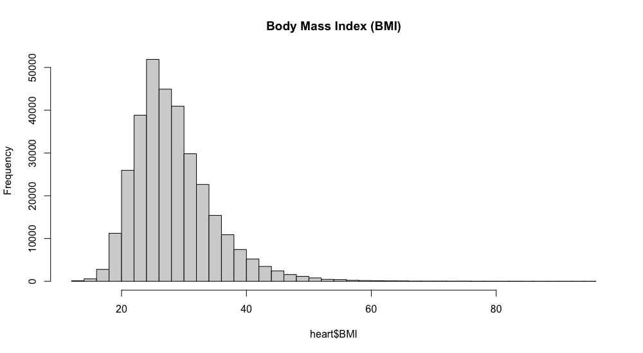

Slide 4
Concepts
Median (m)
Not unduly influenced by outliers or distribution
Ordinal data (Likert scale, rating, education level, etc.)
Order statistics (rank)

Slide 5
Advantages
Tests make fewer assumptions
Tests are often as or more robust than traditional tests
Methods can be easier to use and interpret

Slide 6
Disadvantages
Some tests have less power (larger n needed)
Generally less commonly used and recognized
Some tests don’t have test statistics (only p-values)
Example: Fisher’s exact test

Slide 7
(Incomplete) List of Methods²
Analysis of similarities
Anderson–Darling test
Bootstrap methods
Cochran’s Q
Cohen’s κ
Friedman two-way ANOVA by ranks
Kaplan–Meier
Kendall’s τ
Kendall’s W
Kolmogorov–Smirnov test
Kruskal–Wallis one-way ANOVA by ranks
Kuiper’s test
Log-rank test
Mann–Whitney U (Wilcoxon rank sum) test
McNemar’s test
Median test
Pitman’s permutation test
Rank products
Siegel–Tukey test
Sign test
Spearman’s ρ
Squared ranks test
Tukey–Duckworth test
Wald–Wolfowitz runs test
Wilcoxon signed-rank test

Slide 8
(Incomplete) List of Methods²
Analysis of similarities: tests similarities between groups against similarities within groups
Anderson–Darling test: tests whether a sample is drawn from a given distribution
Bootstrap methods: estimates the accuracy/sampling distribution of a statistic
Cochran’s Q: tests whether k treatments in randomized block designs with 0/1 outcomes have identical effects
Cohen’s κ: measures inter-rater agreement for categorical items
Friedman two-way ANOVA by ranks: tests whether k treatments in randomized block designs have identical effects
Kaplan–Meier: estimates the survival function from lifetime data, modeling censoring
Kendall’s τ: measures statistical dependence between two variables
Kendall’s W: a measure between 0 and 1 of inter-rater agreement
Kolmogorov–Smirnov test: tests whether a sample is drawn from a given distribution, or whether two samples are drawn from the same distribution
Kruskal–Wallis one-way ANOVA by ranks: tests whether > 2 independent samples are drawn from the same distribution
Kuiper’s test: tests whether a sample is drawn from a given distribution, sensitive to cyclic variations such as day of the week
Log-rank test: compares survival distributions of two right-skewed, censored samples
Mann–Whitney U (Wilcoxon rank sum) test: tests whether two samples are drawn from the same distribution, as compared to a given alternative hypothesis
McNemar’s test: tests whether, in 2 × 2 contingency tables with a dichotomous trait and matched pairs of subjects, row and column marginal frequencies are equal
Median test: tests whether two samples are drawn from distributions with equal medians
Pitman’s permutation test: a statistical significance test that yields exact p values by examining all possible rearrangements of labels
Rank products: detects differentially expressed genes in replicated microarray experiments
Siegel–Tukey test: tests for differences in scale between two groups
Sign test: tests whether matched pair samples are drawn from distributions with equal medians
Spearman’s ρ: measures statistical dependence between two variables using a monotonic function
Squared ranks test: tests equality of variances in two or more samples
Tukey–Duckworth test: tests equality of two distributions by using ranks
Wald–Wolfowitz runs test: tests whether the elements of a sequence are mutually independent/random
Wilcoxon signed-rank test: tests whether matched pair samples are drawn from populations with different mean ranks

Slide 9
(Incomplete) List of Methods
Analysis of similarities
Anderson–Darling test
Bootstrap methods
Cochran’s Q
Cohen’s κ
Friedman two-way ANOVA by ranks
Kaplan–Meier
Kendall’s τ
Kendall’s W
Kolmogorov–Smirnov test
Kruskal–Wallis one-way ANOVA by ranks
Kuiper’s test
Log-rank test
Mann–Whitney U (Wilcoxon rank sum) test
McNemar’s test
Median test
Pitman’s permutation test
Rank products
Siegel–Tukey test
Sign test
Spearman’s ρ
Squared ranks test
Tukey–Duckworth test
Wald–Wolfowitz runs test
Wilcoxon signed-rank test

Slide 10
Kendall’s τ
Take all _{n}C₂ = n(n-1) / 2 pairs of points
A pair is concordant if x_{i} < x_{j} and y_{i} < y_{j}
A pair is discordant if x_{i} < x_{j} and y_{i} > y_{j}
τ = (concordant - discordant) / _{n}C₂
Ties (if x_{i} = x_{j} or y_{i} = y_{j})
τ_{A} (ignore)
τ_{B} (RStudio)
τ_{C} (Stuart–Kendall)

Slide 11
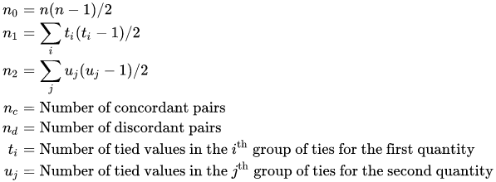


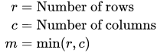
Kendall’s τ
³

Slide 12
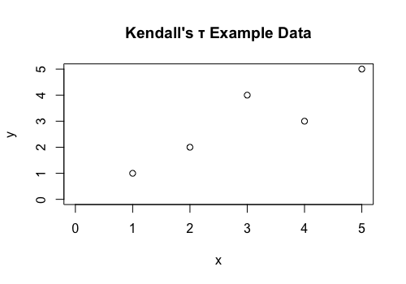
Kendall’s τ Example
cor(x,y,method=”kendall”)
 |  | j
 |  | (1,1) | (2,2) | (3,4) | (4,3) | (5,5)
i | (1,1) |  | C | C | C | C
 | (2,2) |  |  | C | C | C
 | (3,4) |  |  |  | D | C
 | (4,3) |  |  |  |  | C
 | (5,5)
C = 9, D = 1
τ = (9 - 1) / 10 =
τ = 0.8

Slide 13
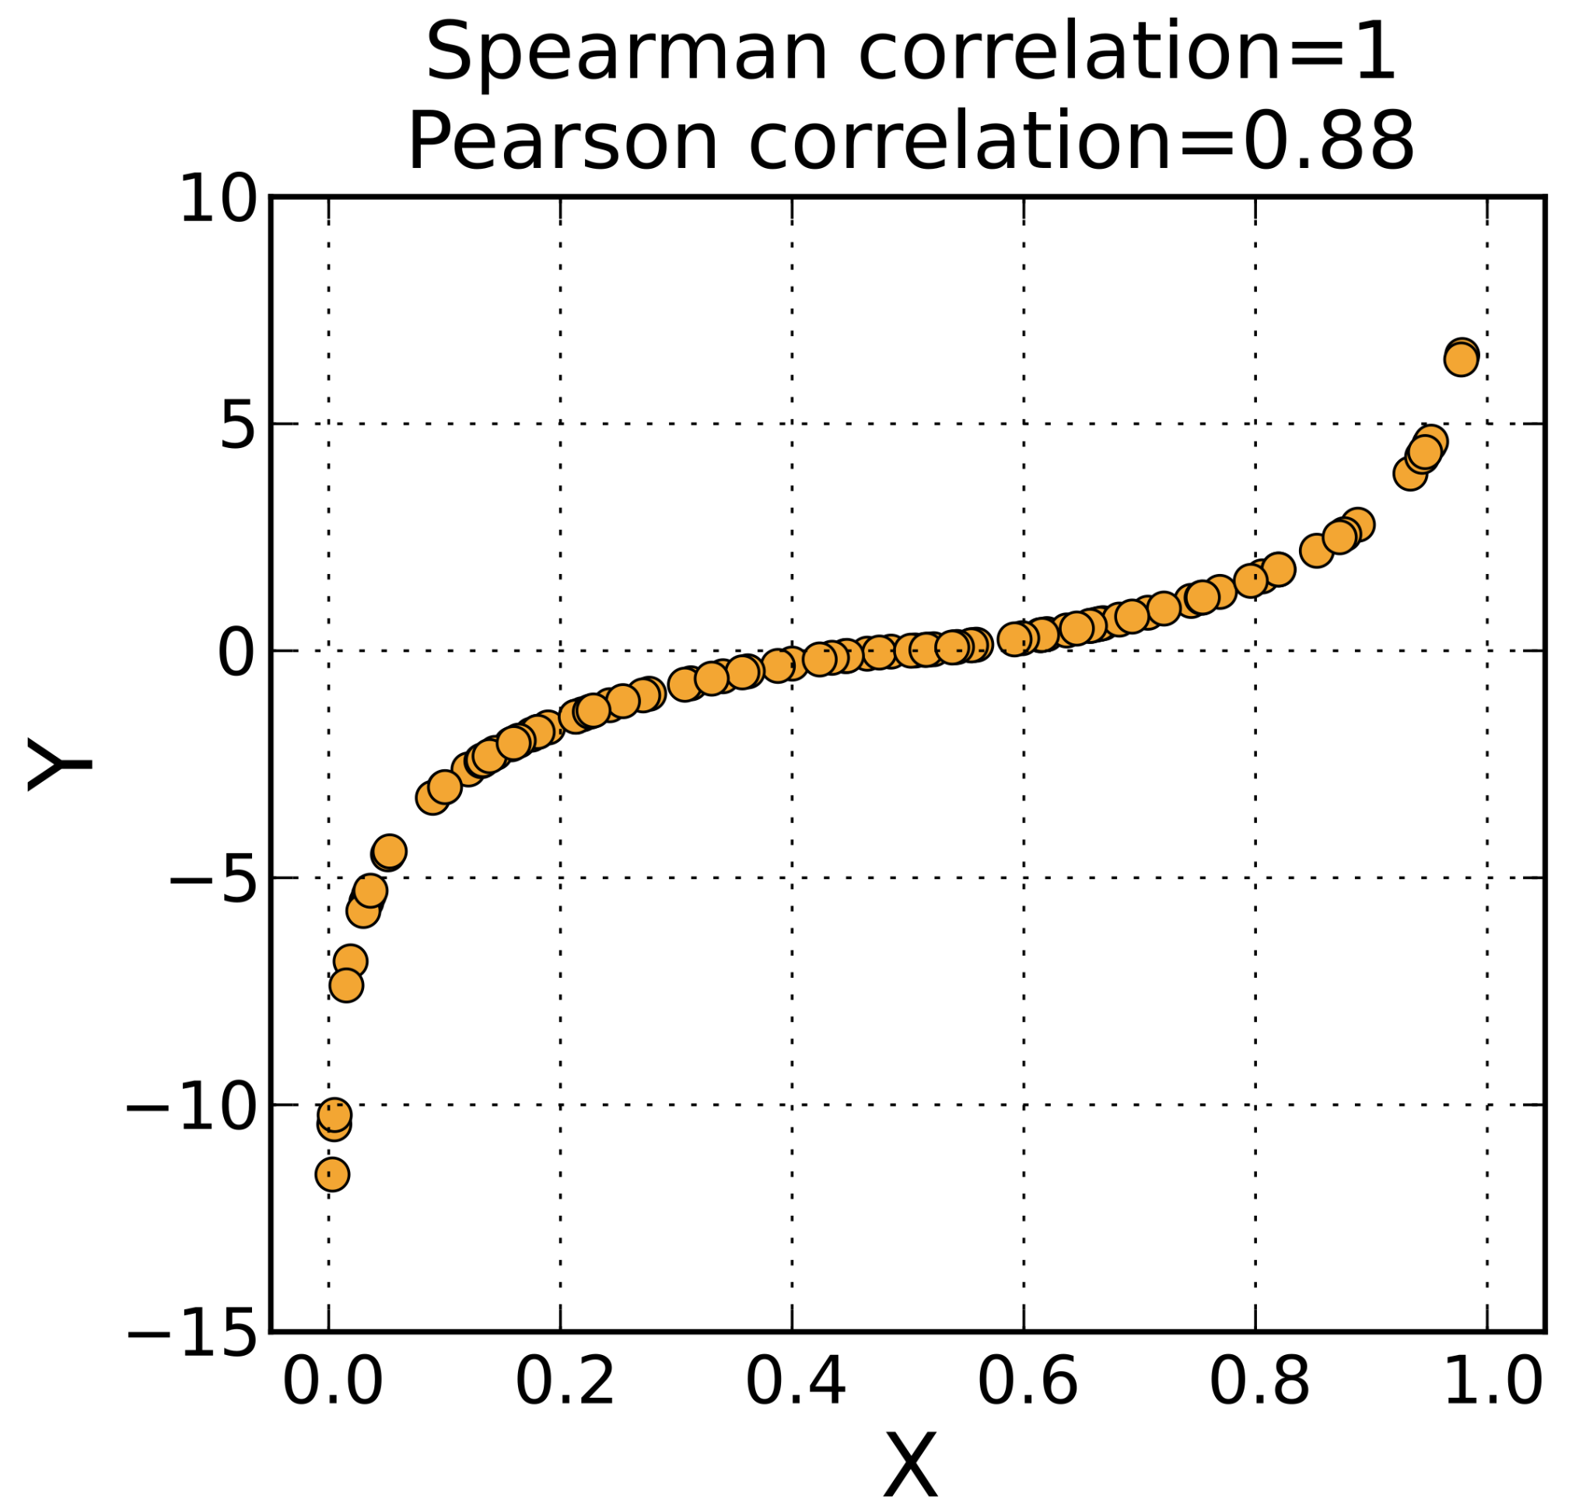
Spearman’s ρ
⁴
Calculates r on ranks
Ties: fractional (mean) ranks
Not unduly affected by outliers or influential points
Useful for data resembling a monotonic function (exponential, logistic, logarithmic, etc.)
cor(x,y,method=”spearman”)

Slide 14
Sign test (paired or one-sample)
Points where x_{i} > y_{i} are ⊕
Points where x_{i} = y_{i} are ∅
Points where x_{i} < y_{i} are ⊖
One-sample: replace y_{i} with η (estimated population median)
H₀: m_{x} - m_{y} = d; H_{A}: m_{x} - m_{y} ≠ d or H₀: m = η; H_{A}: m ≠ η
p = 2 * Binomcdf(⊕; n - ∅, 0.5)
Disadvantage: Low power

Slide 15
Sign test (paired, H₀: m_{x} - m_{y} = 0)
x | 0 | 1 | 2 | 3 | 3 | 4 | 5 | 6 | 7 | 7 | 8 | 9 | 10
y | 1 | 2 | 4 | 3 | 4 | 5 | 6 | 7 | 8 | 8 | 9 | 9 | 9
Sgn | ⊖ | ⊖ | ⊖ | ∅ | ⊖ | ⊖ | ⊖ | ⊖ | ⊖ | ⊖ | ⊖ | ∅ | ⊕
p = 2 * Binomcdf(⊕; n - ∅, 0.5) = 2 * Binomcdf(1; 13 - 2, 0.5) = 0.01171875
binom.test(1,11,p=0.5,alternative=“two.sided”)

Slide 16
Sign test (one-sample, H₀: m = 1)
x | 0 | 1 | 2 | 3 | 3 | 4 | 5 | 6 | 7 | 7 | 8 | 9 | 10
Sgn | ⊖ | ∅ | ⊕ | ⊕ | ⊕ | ⊕ | ⊕ | ⊕ | ⊕ | ⊕ | ⊕ | ⊕ | ⊕
p = 2 * Binomcdf(⊕; n - ∅, 0.5) → 1 - 2 * Binomcdf(11; 13 - 1, 0.5) = 0.006347656
binom.test(11,12,p=0.5,alternative=“two.sided”)

Slide 17


Wilcoxon signed-rank test
Similar to sign test
Points are sorted by absolute difference and ranked (ties ignored)
W⁻ + W⁺ = W = n(n+1) / 2
⁵

Slide 18
Wilcoxon signed-rank test (paired, H₀: m_{x} = m_{y})
x | 100 | 101 | 102 | 103 | 103 | 104 | 105 | 106 | 107 | 107 | 108 | 109 | 110
y | 101 | 100 | 99 | 98 | 97 | 96 | 95 | 94 | 93 | 93 | 92 | 92 | 92
Diff. | -1 | 1 | 3 | 5 | 6 | 8 | 10 | 12 | 14 | 14 | 16 | 17 | 18
R_{i} | 1.5 | 1.5 | 3 | 4 | 5 | 6 | 7 | 8 | 9.5 | 9.5 | 11 | 12 | 13
W⁻ = 1.5
W⁺ = 1.5 + 3 + 4 + 5 + 6 + 7 + 8 + 9.5 + 9.5 + 11 + 12 + 13 = 89.5
W = 89.5, p = 0.002351027
wilcox.test(x,y,paired=TRUE)

Slide 19
Wilcoxon signed-rank test (one-sample, H₀: m = 0)
x | 0 | 1 | 2 | 3 | 3 | 4 | 5 | 6 | 7 | 7 | 8 | 9 | 10
Diff. | 0 | 1 | 2 | 3 | 3 | 4 | 5 | 6 | 7 | 7 | 8 | 9 | 10
R_{i} | — | 1 | 2 | 3.5 | 3.5 | 5 | 6 | 7 | 8.5 | 8.5 | 10 | 11 | 12
W⁻ = 0
W⁺ = 1 + 2 + 3.5 + 3.5 + 5 + 6 + 7 + 8.5 + 8.5 + 10 + 11 + 12 = 78
W = 78, p = 0.002506842
wilcox.test(x,alternative=”two.sided”)

Slide 20



Mann–Whitney U (Wilcoxon rank sum) test
Similar family of tests for non-paired two-sample
H₀: m_{x} - m_{y} = d; H_{A}: m_{x} - m_{y} ≠ d
U₁ = Σ_{i=1}^{n1} R₁ - n₂(n₂+1)/2 U₂ = Σ_{i=1}^{n2} R₂ - n₁(n₁+1)/2
⁶

Slide 21
Mann–Whitney U (Wilcoxon rank sum) test
x, y | 0 | 1 | 2 | 3 | 3 | 4 | 5 | 6 | 7 | 7 | 8 | 9 | 10
R_{x} | 1 | 2 | 3 | 4.5 |  | 6 |  | 8
R_{y} |  |  |  |  | 4.5 |  | 7 |  | 9.5 | 9.5 | 11 | 12 | 13
U₁ = 1 + 2 + 3 + 4.5 + 6 + 8 - n₂(n₂+1)/2 = 24.5 - 6*7/2 = 3.5
U₂ = 4.5 + 7 + 9.5 + 9.5 + 11 + 12 + 13 - n₁(n₁+1)/2 = 66.5 - 5*6/2 = 51.5
W = 3.5, p = 0.01488064
wilcox.test(x,y,alternative=”two.sided”)

Slide 22
Kolmogorov–Smirnov test
One-sample (Kolmogorov) or two-sample (Smirnov)
H₀: The data are from a certain/the same distribution
H_{A}: The data are not from a certain/the same distribution
Disadvantage: less power
Normal distribution: Shapiro–Wilk test
Anderson–Darling test gives more weight to tails

Slide 23
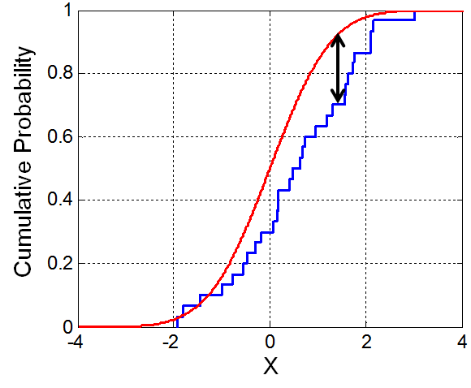
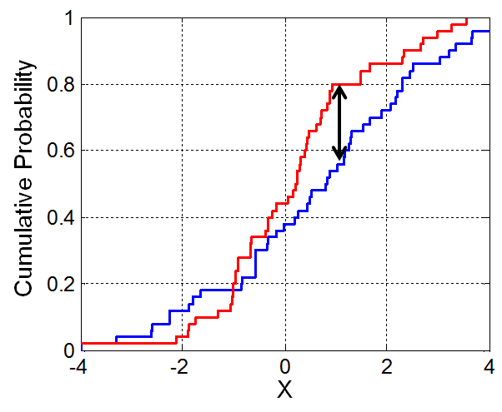


Kolmogorov–Smirnov test⁷
ks.test(x,y)

Slide 24
McNemar’s (MACK-neh-MARS) test
2×2 | Y | N | Tot
Y | a | b | a+b
N | c | d | c+d
Tot | a+c | b+d | n
Tests for marginal homogeneity (paired data)
H₀: b = c; H_{A}: b ≠ c
χ²₍₁₎ = (b - c)² / (b + c)
mcnemar.test(x)

Slide 25
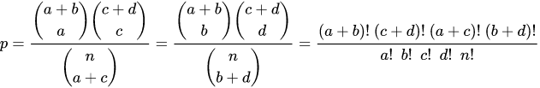
Bonus: Fisher’s exact test
2×2 |  |  | Tot
 | a | b | a+b
 | c | d | c+d
Tot | a+c | b+d | n
H₀: The two variables are independent
H_{A}: The two variables are not independent
fisher.test(x,alternative=”two.sided”)
⁸

Slide 26
Conclusion
Nonparametric statistics is an entire subsection of statistics
Nonparametric tests can be used when assumptions of traditional tests are violated
Most real-world data are not normally distributed

Slide 27
References
https://www.luc.edu/media/lucedu/math/docs/Stat-Grid.pdf
Hollander, Myles, Douglas A. Wolfe and Eric Chicken. Nonparametric Statistical Methods. 3rd ed., Wiley-Blackwell, 2014.
https://en.wikipedia.org/wiki/Nonparametric_statistics#Methods
https://en.wikipedia.org/wiki/Kendall_rank_correlation_coefficient#Accounting_for_ties
https://commons.wikimedia.org/wiki/File:Spearman_fig1.svg
https://en.wikipedia.org/wiki/Wilcoxon_signed-rank_test#Computing_the_null_distribution
https://en.wikipedia.org/wiki/Mann%E2%80%93Whitney_U_test
https://en.wikipedia.org/wiki/Kolmogorov%E2%80%93Smirnov_test
https://commons.wikimedia.org/wiki/File:KS_Example.png
https://commons.wikimedia.org/wiki/File:KS2_Example.png
https://en.wikipedia.org/wiki/Fisher%27s_exact_test#Example

Slide 28
Questions?

